Slide 1




UK TRAIN RIDES
Presentation
Team Members
1. Omar Mahmoud Hassan
2. Salma Mohamed Mustafa
3. Nouran Mansour Ahmed
4. Ahmed Mohammed Ahmed Elsisy
5/9/2025
1

Slide 2
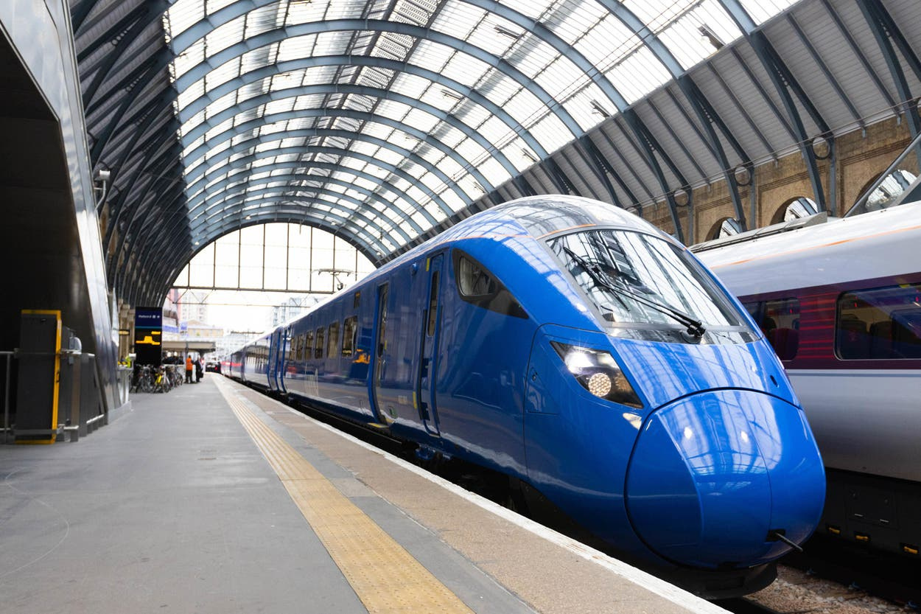
INTRODUCTION
The UK Train Rides Report project was developed to provide a comprehensive analysis of railway operations in the United Kingdom. This initiative aims to identify and address key operational issues while enhancing the overall passenger experience.
Focus on realistic, time-specific data (Dec2023–Apr 2024).
Includes detailed ticket attributes: type, price, time, stations.
Highlights trends through custom visualizations and meaningful graphs.
Our goal is to uncover insights that improve service reliability and passenger satisfaction.
2

Slide 3
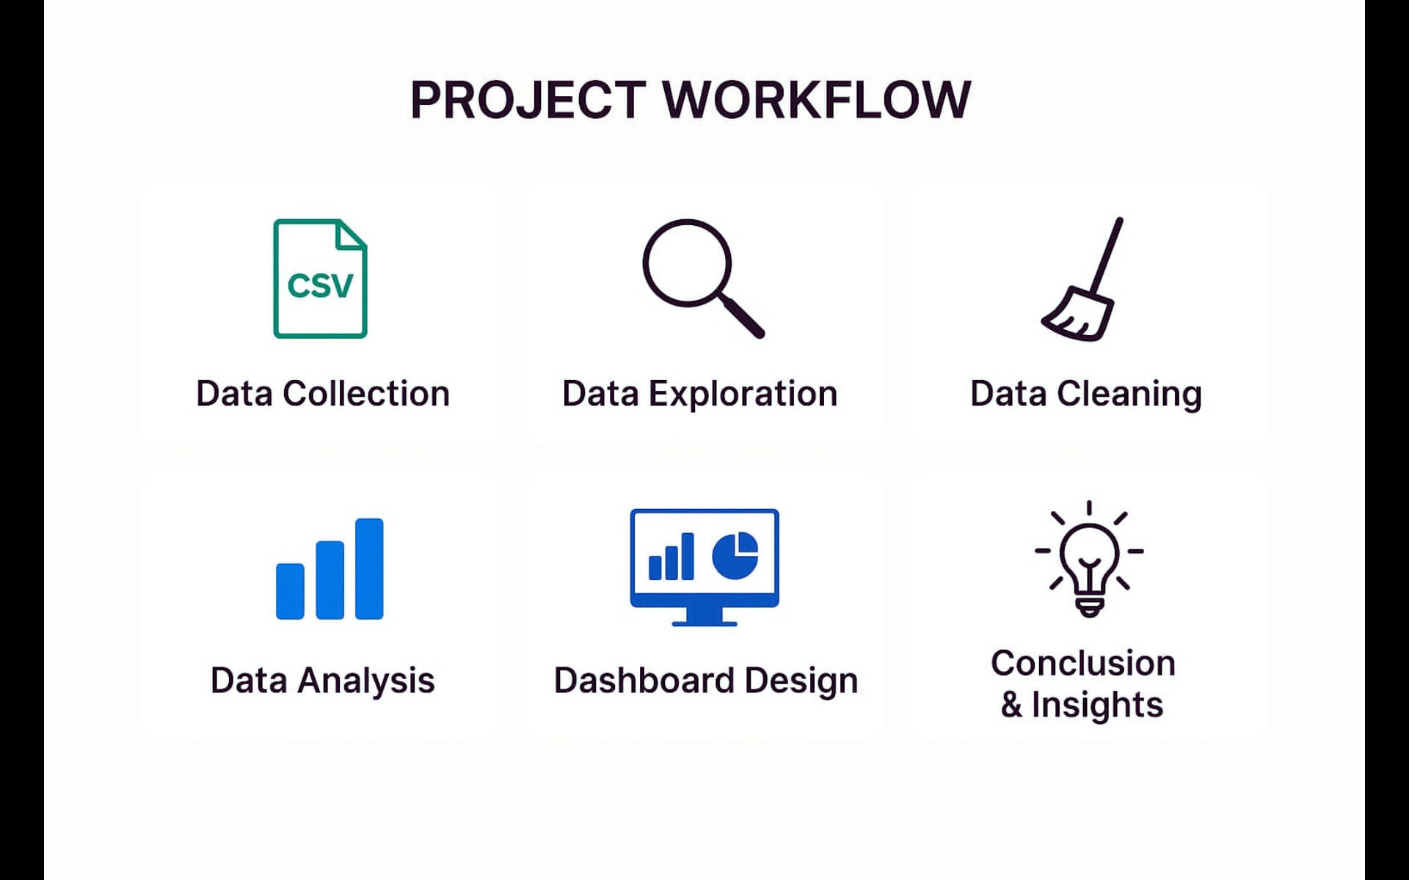
Key Steps:
1
Data Collection
Data Analysis
Dashboard Design
Data Exploration
Conclusion& Insight
Data Cleaning
3

Slide 4
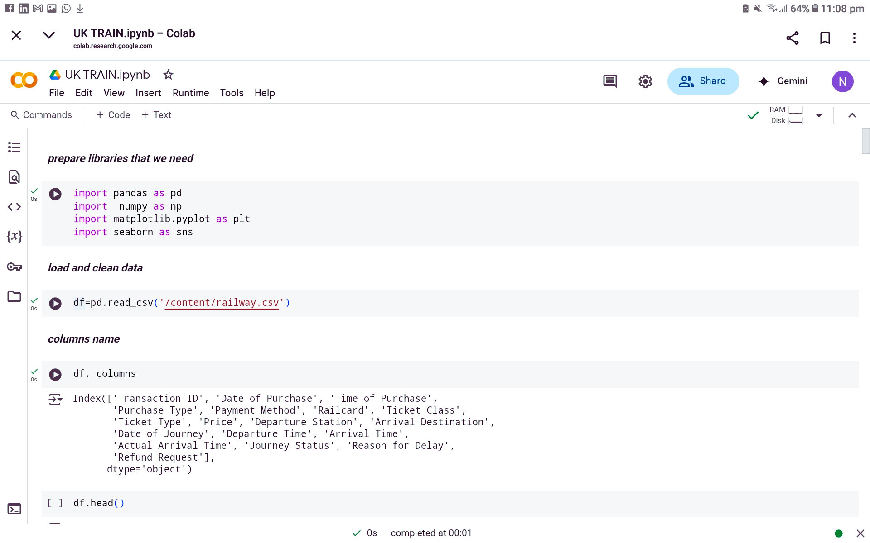
Data Exploration and Cleaning using python
4

Slide 5
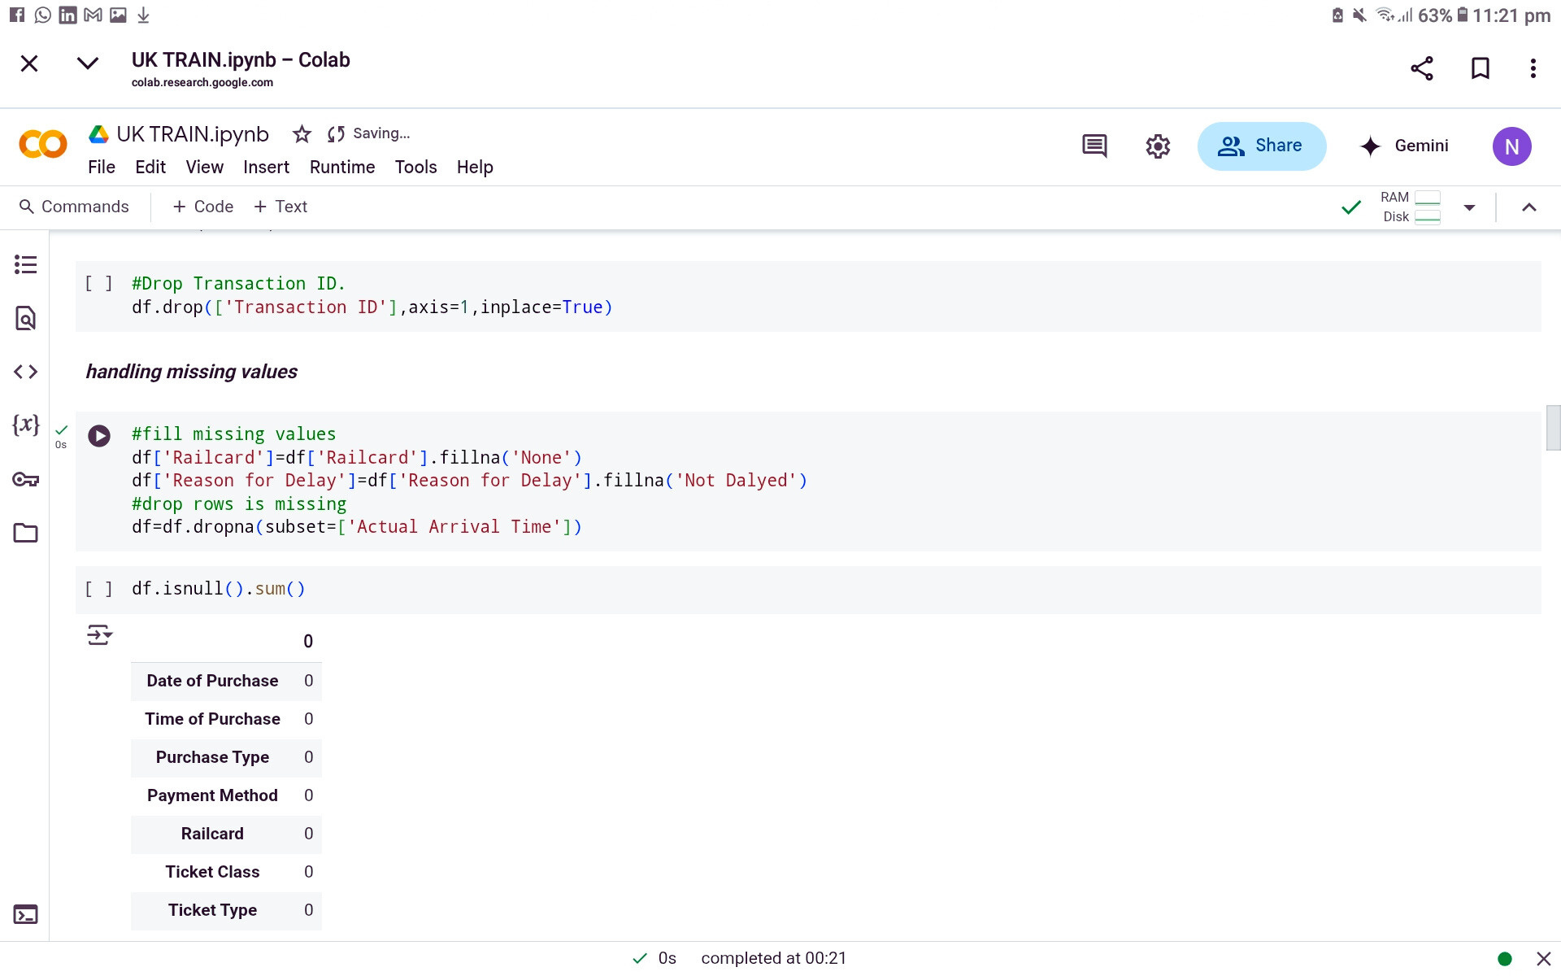
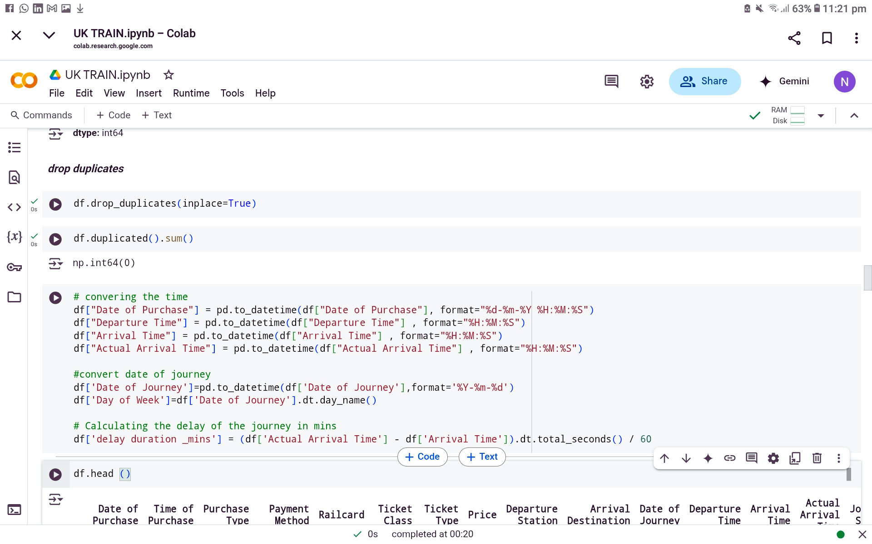
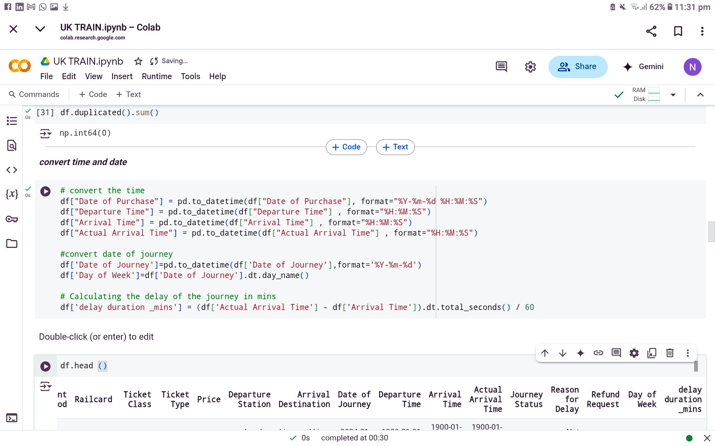
Data Exploration and Cleaning using python
5

Slide 6
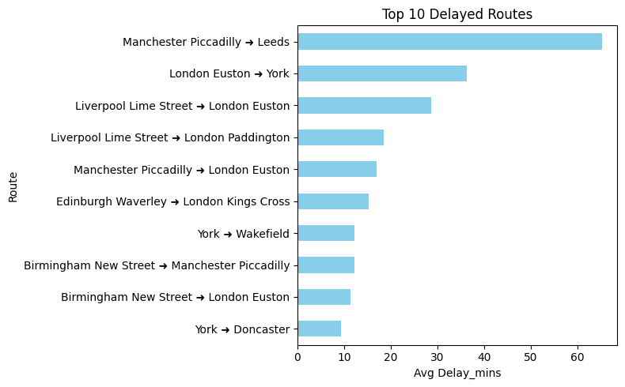
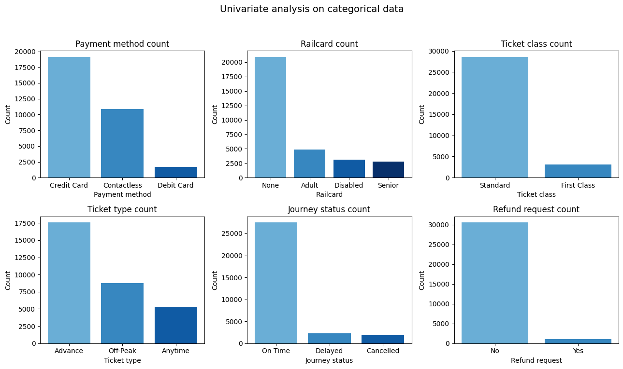
Data Analysis
Top 10 Delayed Routes
Journey Status
The majority of journeys were on time, with a notable proportion experiencing delays.
These are the routes with the most consistent delays.
6

Slide 7
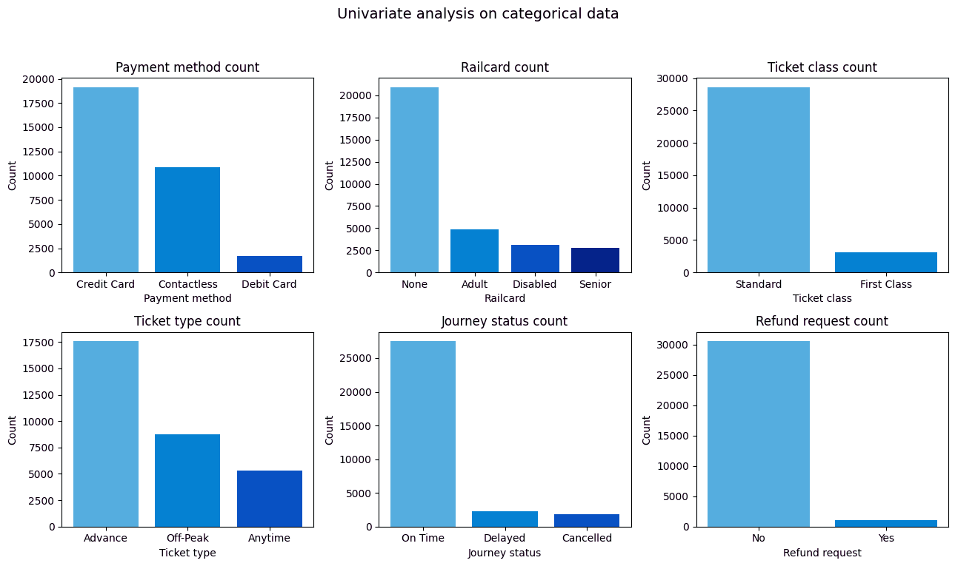
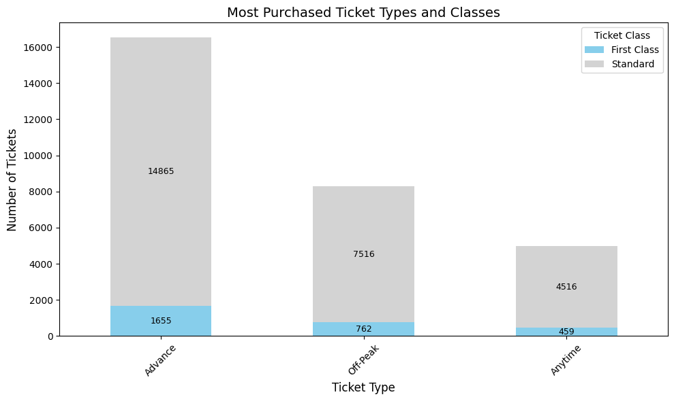
Data Analysis
Most Purchased Ticket Type and Class
Payment Method
Advance tickets are the most commonly purchased, with a clear preference for Standard class across all ticket types.
Credit cards dominate as the preferred payment method, followed by contactless options.
7

Slide 8
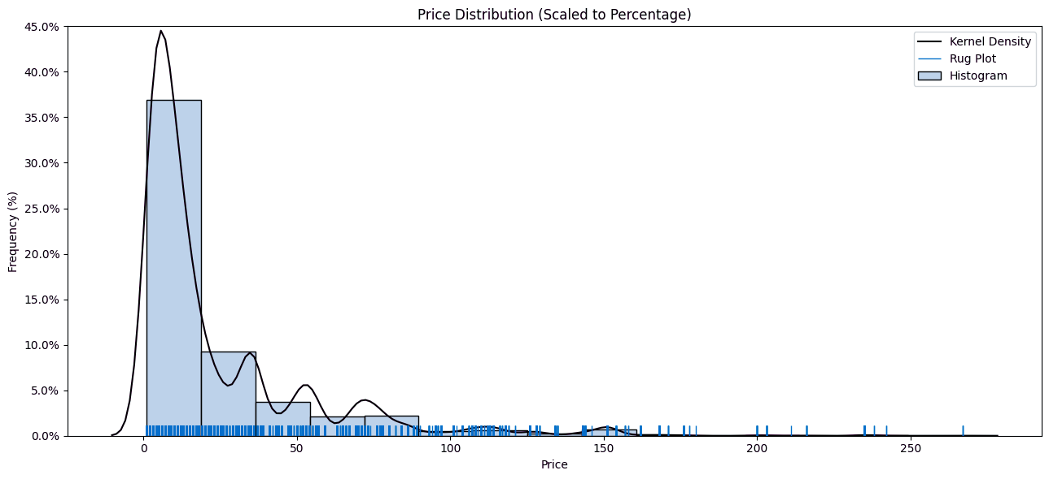
Data Analysis
Price Distribution
Most ticket prices are concentrated in the under £20 category, indicating that the majority of trips are economical, with only a few cases of higher prices.
8

Slide 9
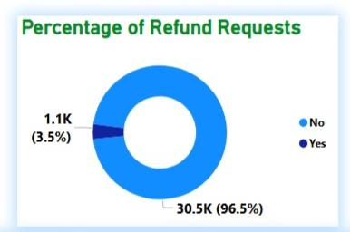
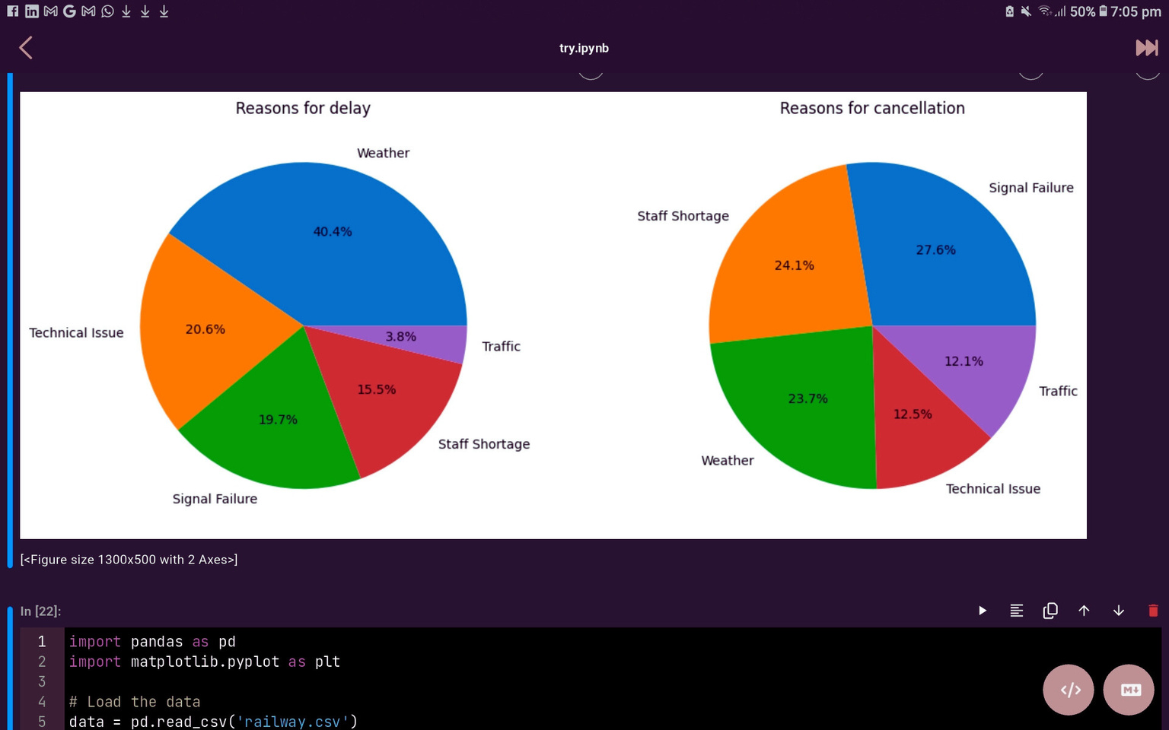
Data Analysis
Refund Request
Reasons for delay
Reasons for cancellation
Despite delays and cancellations, refund requests were rare, making up 3.5% of all tickets.
Delays mainly result from weather and technical issue.
Most cancellation are due to signal failures and staff shortages.
9

Slide 10
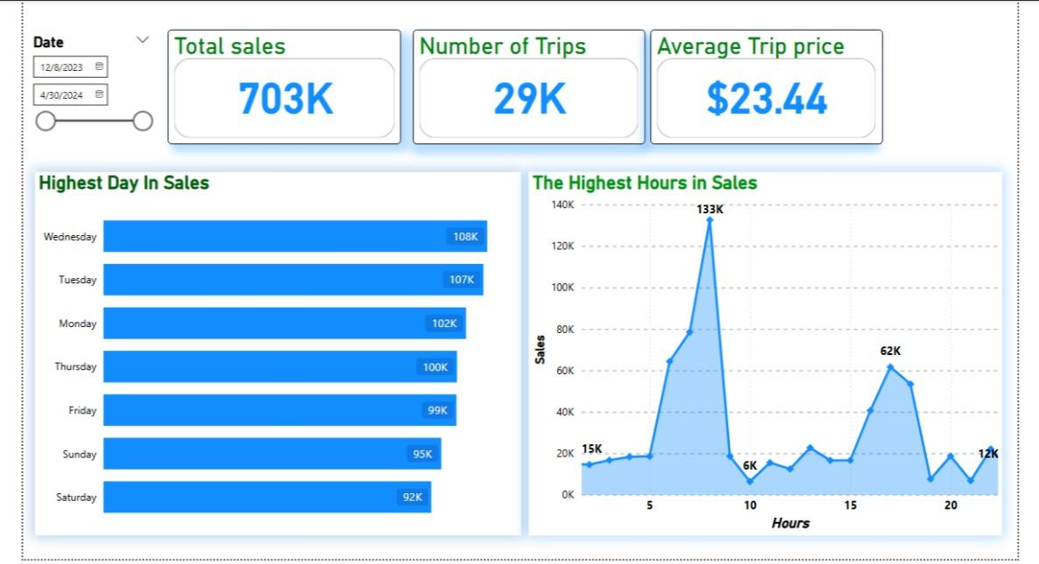
Uk Train Dashboard
Online sales represent the majority of purchases. Sales peak midweek, especially on Wednesdays and Tuesdays. Advance tickets are the most popular
10

Slide 11
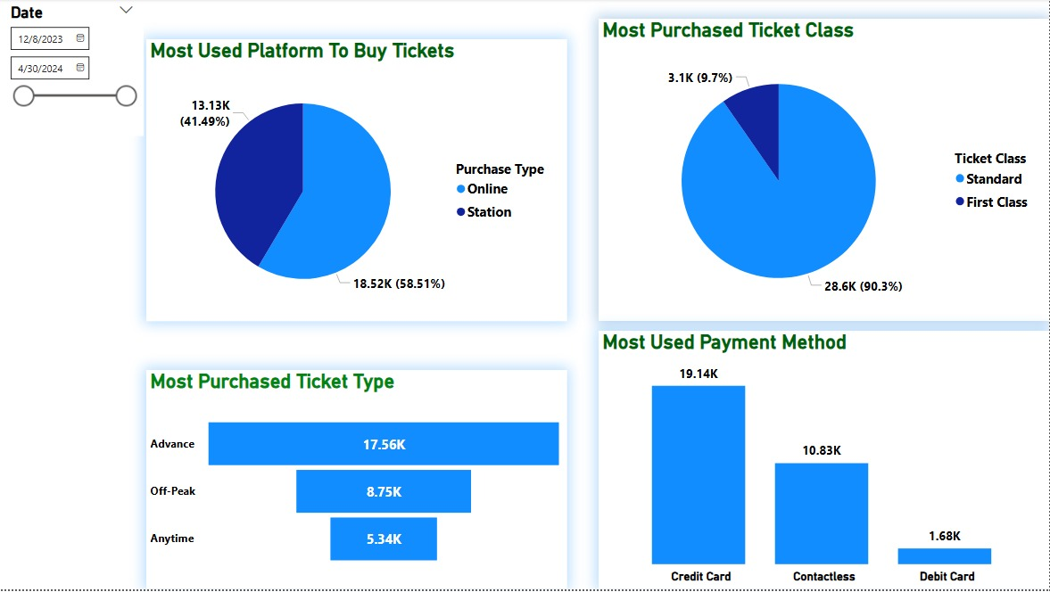
Uk Train Dashboard
"Most delays occur between 9–12 AM and again after 4 PM. The Manchester–Leeds route experiences the highest average delay.
11

Slide 12
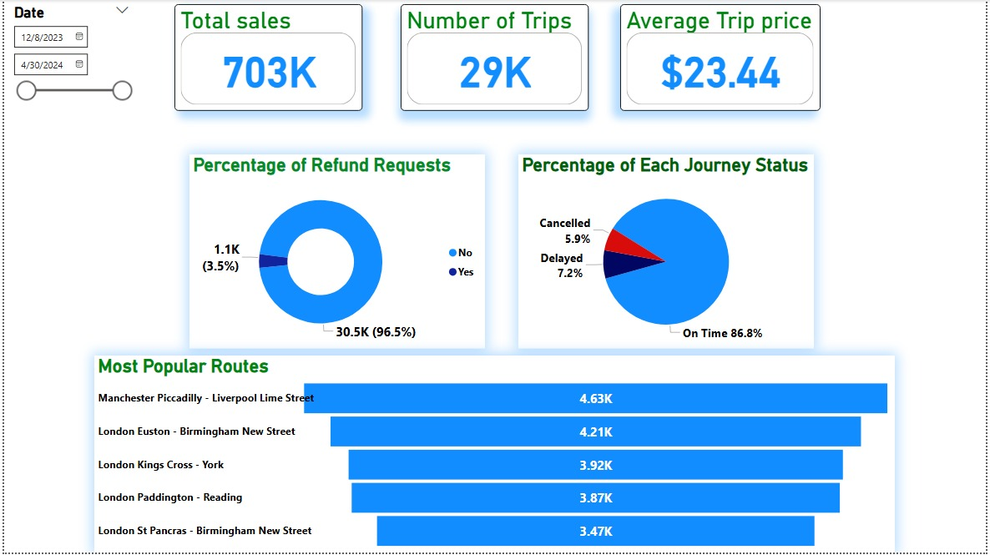
Uk Train Dashboard
Over 86% of journeys arrive on time. Refund requests remain low at 3.5%. Credit card is the leading payment method. Manchester Piccadilly is the busiest station.
12

Slide 13
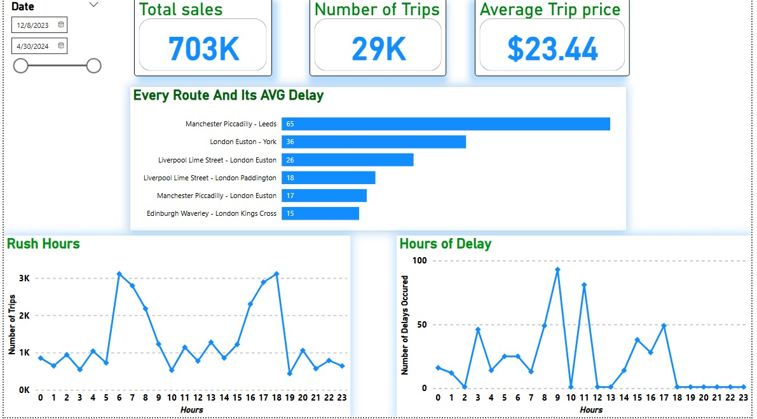
Uk Train Dashboard
Over 86% of journeys arrive on time. Refund requests remain low at 3.5%. Credit card is the leading payment method. Manchester Piccadilly is the busiest station.
13

Slide 14
Key Insights
1. Peak hours show the highest delay frequency
Train delays increase significantly between 9 AM– 12 PM and after 4 PM, the need for better schedule planning during rush hours.
2. Technical failures and signal issues impact reliability
System breakdowns and signal malfunctions are among the top contributors to trip cancellations and delays.
3. Certain routes experience repeated and extended delays
Some train routes consistently underperform, indicating a need for targeted operational improvements.
4. Digital payments are the preferred method for most passengers
A clear shift toward contactless and card payments reflects passenger demand for fast, convenient transaction methods.
5. Weather conditions are a major cause of train delays
Weather disruptions frequently affect trip punctuality, highlighting the need for stronger infrastructure resilience.
14

Slide 15
Recommendation
1. Manage Rush Hours Effectively
Optimize train schedules and increase frequency during peak periods—especially between 9 AM–12 PM and after 4 PM—to reduce congestion and delays.
2. Address Technical and Signal Issues
Prioritize the maintenance and upgrade of systems to minimize technical failures and signal malfunctions that impact service reliability.
3. Improve High-Delay Routes
Conduct detailed operational reviews of the most delay-prone routes to identify and address recurring performance issues.
4. Promote Digital Payments
Continue expanding support for card and mobile payment options, in line with passenger preferences for fast and contactless transactions.
5. Enhance Weather Resilience
Invest in infrastructure and preventive measures to reduce delays caused by weather disruptions, which are a leading source of service interruptions.
15

Slide 16

16

